Slide 1
Financial Incentives, Hospital Care, and Health Outcomes: Evidence from Fair Pricing Laws
Jingxuan Zhao
09/07/2022

Slide 2
Outline

Slide 3
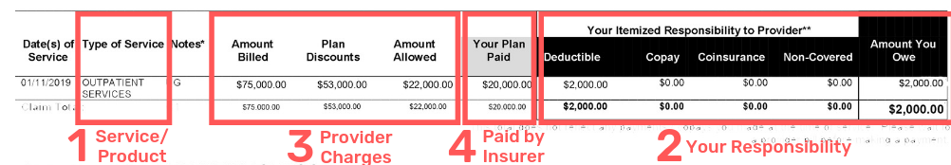
Background
Amount the uninsured patients owe

Slide 4
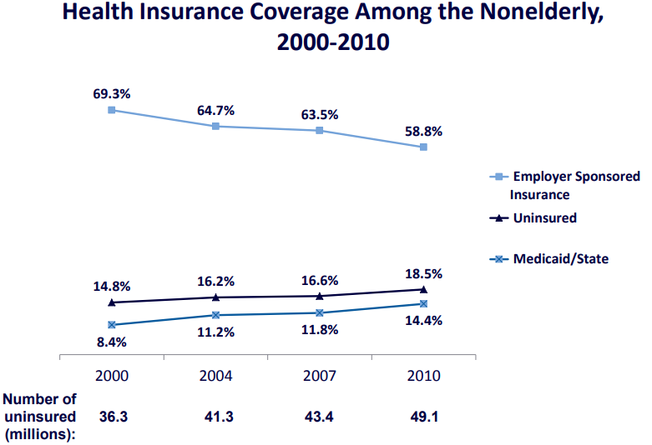
Source: Urban Institute, 2011. Based on data from the 2001-2011 ASEC Supplement to the CPS.

Slide 5
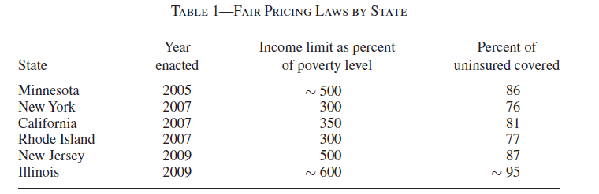
Fair Pricing Laws (FPL)
To limits collections from most uninsured patients (below an income cap).
Require hospitals provide free care to low to middle income uninsured patients.
Not all states adopted FPL at the time of the study.

Slide 6
Study Objectives
Payment
Fair Pricing Laws
Quantity
Quality

Slide 9
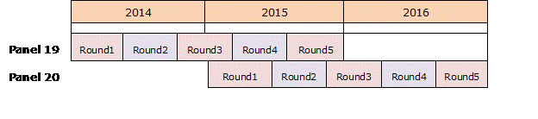
Fair Pricing Laws and Payment
Data: Medical Expenditure Panel Survey (MEPS)
Nationally representative.
Monthly indictors of health insurance coverage (private, Medicaid, uninsured…) (24 in total for each person)
Health expenditure information, by type of service, by payment resource
Other information: health condition, access to care, etc.
State is not publicly available.

Slide 10
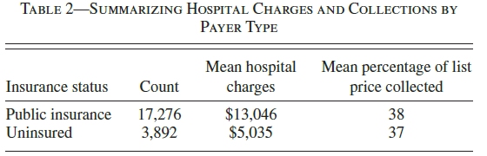
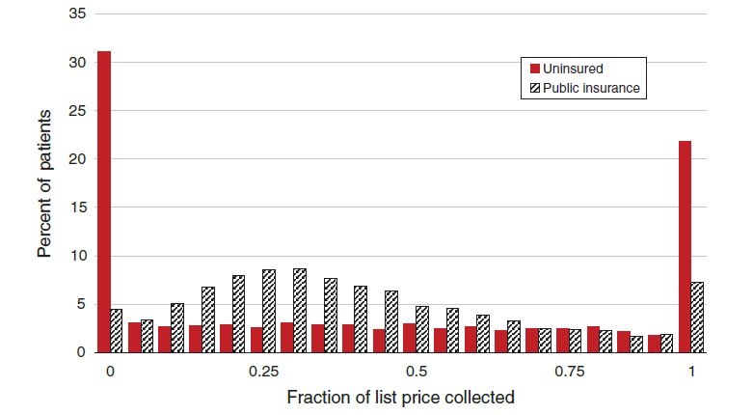
Fair Pricing Laws and Payment
Study Sample
all patients with either public (control group) or no insurance in the MEPS between 2000 and 2004 who went to the hospital at least once

Slide 11
Fair Pricing Laws and Payment
Statistical Methods
Compare payments from uninsured patients before and after FPLs

